Slide 1
HOSPITAL FINDER APP
PIP2001 Capstone Project
Review-1
Batch Number: 32
Under the Supervision of,
Ms. Ayesha Taranum
Assistant Professor
School of Computer Science & Engineering
Presidency University
Roll Number | Student Name
20211CSE0115 | B Sharath Chandra Reddy
20211CSE0118 | V Meghanatha Reddy
20211CSE0518 | N Keshava Reddy
20211CSE0124 | K Venakta Sainath Reddy
Name of the Program: COMPUTER SCIENCE and ENGINEERING(CSE)
Name of the HoD: Dr. Asif Mohammed
Name of the Program Project Coordinator: Mr. Amarnath J L
Name of the School Project Coordinators: Dr. Sampath A K / Dr. Abdul Khadar A / Mr. Md Ziaur Rahman

Slide 2
Introduction
Hospital Finder App, a solution aimed at simplifying access to healthcare services. In today's healthcare environment, finding the right medical assistance quickly is essential. Our app allows users to explore hospitals, check the availability of doctors, and find medical resources with ease.
The app is designed to provide up-to-date information about healthcare facilities, helping users make informed decisions for their medical needs, whether it’s for general consultation or specialized treatment. Our goal is to enhance the efficiency of healthcare access by empowering users with accurate and reliable data.
In today’s world, access to healthcare is more important than ever. Whether in emergencies or routine medical care, finding the right hospital and healthcare provider can be challenging and time-sensitive.

Slide 3
Literature Review
Doctor Availability and Hospital Capacity Research by Zhang et al. (2020) emphasized the importance of real-time doctor availability and hospital capacity data. They found that without knowing the availability of specific medical professionals, patients often experience frustration and increased waiting times, especially during emergencies.
User-Centered Design in Healthcare Apps User-centered design has been recognized as a critical factor in the success of healthcare applications. A study by Adams and Brown (2018) underscored that healthcare apps must be intuitive and easy to use for people of all ages.
Healthcare Apps During the COVID-19 Pandemic The COVID-19 pandemic highlighted the necessity for efficient healthcare information systems. A review by Johnson et al. (2021) found that during the pandemic, applications that provided real-time updates about hospital availability and resources played a pivotal role in managing patient flow and reducing overcrowding.
Emergency Healthcare and Mobile Solutions In emergency healthcare scenarios, the availability of real-time information and instant access to hospitals and healthcare facilities is critical. Mobile apps that integrate emergency services have been shown to improve the speed at which patients receive care. A study by Smith et al. (2018).

Slide 4
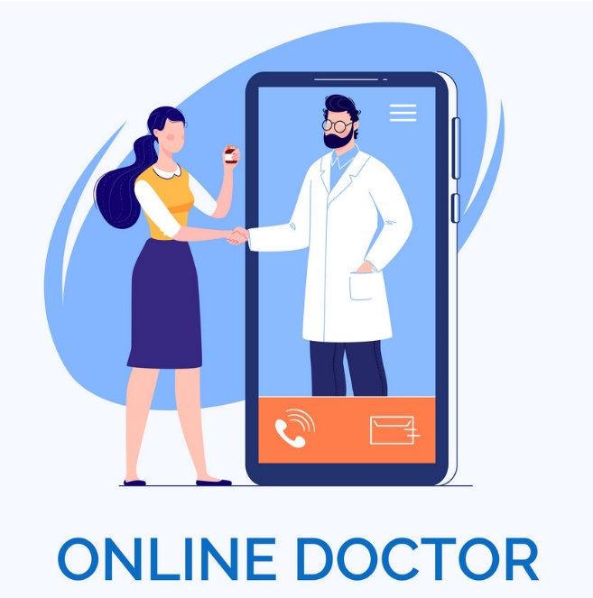
Existing method Drawback
This application can be improved in the future by adding the following functionalities:
Traditional Search Engines
Hospital Websites and Phone Calls
Appointment-Booking Apps
Emergency Services (Ambulance Apps)
Limited Regional Coverage

Slide 5
Proposed Method
Key Proposed Features to Address the Drawbacks
Real-Time Data Feeds Hospitals will be integrated into the app through APIs or manual updates, ensuring users receive the most current data on bed capacity, doctor availability, and emergency services.
Centralized Platform Instead of relying on separate hospital websites or phone calls, the app consolidates all necessary information in one place, making it faster and easier for users to find the healthcare services they need.
Emergency-Ready Functionality A specialized emergency alert feature allows users to quickly find hospitals that can handle urgent cases, reducing delays in care. Users will also have the ability to share their location with emergency contacts or responders.
Comprehensive Regional Coverage The app will focus on including rural and semi-urban hospitals, providing broader coverage for underrepresented regions and ensuring healthcare access for all.
User-Centered Design With a simple, user-friendly interface, the app will make it easy for people of all ages and technical skill levels to quickly access medical services, even in high-pressure situations.

Slide 6
Objectives
Improve Access to Healthcare Services
Enhance Efficiency in Finding Medical Care
Provide Real-Time Hospital and Doctor Data
Streamline Emergency Healthcare Access
Increase Healthcare Coverage for Rural Areas
Create a User-Friendly Interface
Facilitate Personalization and Data Management
Support Preventive Healthcare

Slide 7
Methodology/Modules
Planning
Conduct research on user needs and technical requirements.
Establish partnerships with hospitals and medical professionals to gather real-time data.
2.Design
Create wireframes and prototypes of the app to visualize the user journey.
Design an intuitive UI that supports both routine healthcare searches and emergency scenarios.
3.Development
Build the backend with APIs to integrate hospital and doctor data.
Implement the front-end design using mobile app development frameworks like Flutter or React Native.
Test the functionality of each module (hospital search, doctor availability, emergency alerts).
4.Testing
Conduct unit testing for individual modules and end-to-end testing to ensure seamless functionality.
Perform stress testing to evaluate app performance under high traffic, particularly for emergency scenarios.
5.Deployment and Maintenance
Deploy the app on relevant app stores (Google Play, Apple App Store).
Monitor app performance and user feedback to improve and maintain the app continuously.

Slide 8
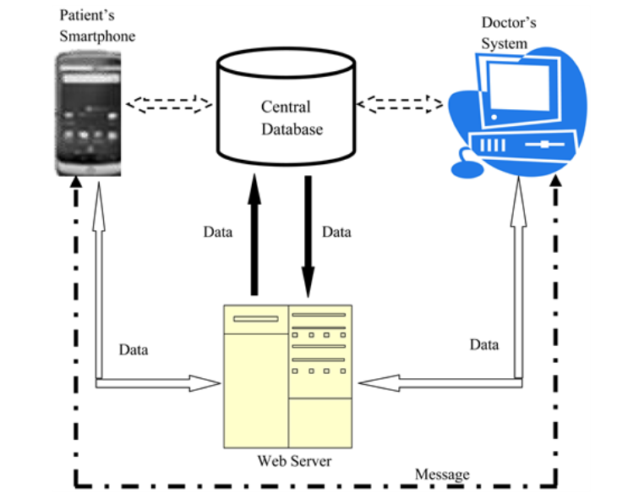
Architecture

Slide 9
Hardware/software components
Database Management System (DBMS) for storing hospital/doctor data.
Mobile app development platform (e.g., Android Studio).
Data Sets
Tools: Node.js, Django, or Spring Boot.
HTML & HTML5
CSS

Slide 10
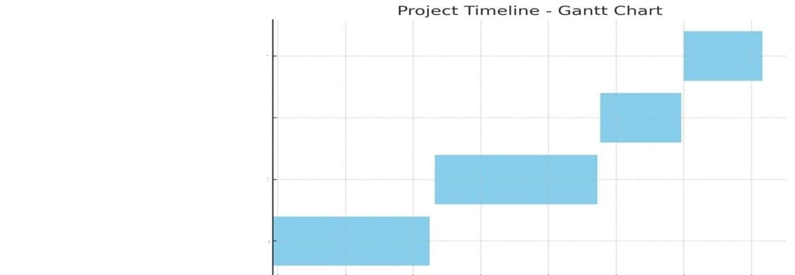
Timeline of the Project (Gantt Chart)
Final Report and Presentation
Testing and Refinement
Development of App(Frontend & Backend)
Research and Analysis

Slide 11
Expected Outcomes
1)Improved Healthcare Accessibility
The app will make it easier for users to locate nearby hospitals and doctors based on real-time data, ensuring faster access to medical services, especially in emergencies.
2)Faster Emergency Response
By providing real-time information about available hospital resources and nearby emergency services, users will experience reduced waiting times and quicker decision-making during critical situations.
3)Better Appointment Management
Users will be able to book appointments with doctors seamlessly, reducing the time and effort spent finding available slots. This will streamline the healthcare process for routine check-ups and specialist visits.
4) Enhanced User Experience
The user-friendly interface and intuitive design will ensure that users can quickly search for hospitals, check availability, and manage their healthcare needs with minimal friction.
5) Real-Time Updates and Data Accuracy
The integration with hospital management systems will provide up-to-date information, allowing users to make informed decisions about where to seek care based on current hospital capacity and doctor availability.
6) Increased Coverage for Rural Areas
By including hospitals from rural and semi-urban regions, the app will bridge the gap in healthcare accessibility, making medical services more available to underserved populations
7) Improved Healthcare System Efficiency
Hospitals can optimize their operations by sharing real-time data with the app, leading to better patient distribution and resource utilization (e.g., bed management and emergency room allocation).
8) Personalized Healthcare
By allowing users to store their medical history and preferences, the app will provide personalized recommendations, helping users find the best-fit hospitals and doctors according to their health needs.

Slide 12
Conclusion
The Hospital Finder App presents a practical solution to the pressing challenge of accessing healthcare services efficiently and promptly. By providing users with real-time information about doctor availability, hospital resources, and the ability to book appointments, the app significantly improves the healthcare experience. Through the integration of hospital management systems and real-time data synchronization, the app ensures that users can make informed decisions about where and when to seek medical attention.
The app’s focus on user-friendly design and essential features, such as real-time updates on hospital capacities and available doctors, streamlines the process of accessing healthcare without relying on location-based services. Instead, it emphasizes the importance of up-to-date medical resource management and efficient communication between patients and healthcare providers.

Slide 13
Github Link
The Github link provided should have public access permission.
Github Link
https://github.com/SAINATH18-hub/CSE-G32-CAPSTONE-PROJECT

Slide 14
References
National Institute of Standards and Technology (NIST). (2020). Digital Identity Guidelines: Authentication and Lifecycle Management. Retrieved from https://nvlpubs.nist.gov/nistpubs/SpecialPublications/NIST.SP.800-63b.pdf
Waskito , A. A., Arifin, A., & Nuh, M. (2022, July). Optimization of Emergency Department Bed Availability using Patient Detection System. In 2022 International Seminar on Intelligent Technology and Its Applications (ISITIA) (pp. 48-51). IEEE
Eshraq Ali Alweshail, Hajar Brahim: "A Smartphone Application to Provide the Health Care Services at Home Eshraq Ali Alweshail, Hajar Brahim", IEEE Access, pp:100-107, (2020).
Pecoraro, F., Luzi, D. and Clemente, F., 2021. The efficiency in the ordinary hospital bed management: A comparative analysis in four European countries before the COVID-19 outbreak. Plos one, 16(3), p.e0248867.
Adamopoulou, E., & Moussiades, L. (2020). An overview of chatbot technology. Artificial Intelligence Review, 53(1), 345-374.

Slide 15
References
Waskito, A. A., Arifin, A., & Nuh, M. (2022, July). Optimization of Emergency Department Bed Availabilty using Patient Detection System. In 2022 International Seminar on Intelligent Technology and Its Applications (ISITIA) (pp. 48-51). IEEE
Geetha, Selvaraj, Samayan Narayanamoorthy, Thangaraj Manirathinam, and Daekook Kang. "Fuzzy case-based reasoning approach for finding COVID-19 patients priority in hospitals at source shortage period." Expert Systems with Applications 178 (2021): 114997.
Inoue, M., Taguchi, R. and Umezaki, T., 2018, July. Visionbased bed detection for hospital patient monitoring system. In 2018 40th Annual International Conference of the IEEE Engineering in Medicine and Biology Society (EMBC) (pp. 5006-5009). IEEE.

Slide 16

Project work mapping with SDG

Slide 17
Thank You

